Slide 1


Slide 2

FINAL PROJECT

Slide 3
Group Members
SYED BILAL ZAHID
REHAN ALI CH.
MUHAMMAD JUNAID ZAFER
FAROOQ AHMAD DAR

Slide 4


HOW 2 INCREASE BANK PROFITABILITY

Slide 5



Slide 6


Branch Banking
Personal Loan
Consumer Banking
UBL Drive
E-Banking
Cash Line
Corporate
Banking
Foreign trade and
correspondent banking
Foreign currencies remittance facility

Slide 7

Measures to improve the profitability and efficiency level of UBL

Slide 8
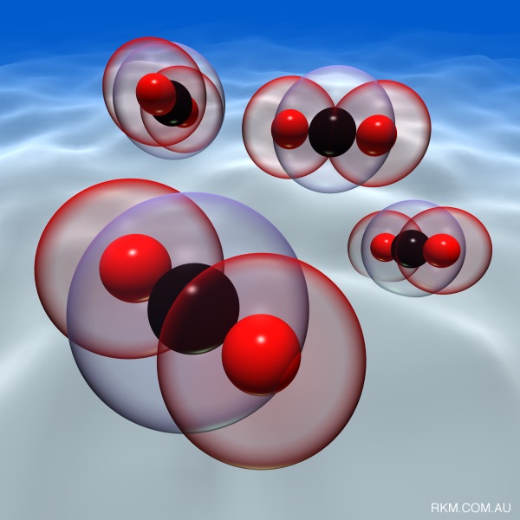
Product Attributes:
The sales of any product or services immensely
depends upon product or service attributes.
Supporting Categories
Branding
Packaging
Labeling
Product Support Services

Slide 9


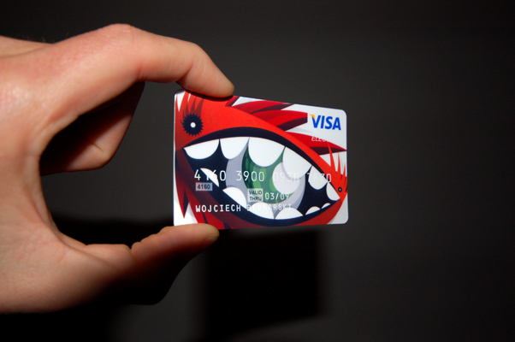
Product Attributes:
Product Quality
Product’s overall durability and reliability, so that the customer come back
Product Feature
Different features from competitors, first and new feature.
Product Style & Design
A better style and design is the strong competitive edge.

Slide 10



Supporting Categories
Branding
UBL has its distinct and unique monogram which upholds and differ it from
others banks. Its color, its design is different from other financial institutions
and UBL name is providing value to the products.
Packaging
Product packaging adds to the product’s durability and long life.( Like credit card )
AND EASY USER GUIDE SHOULD BE PROVIDED FOR CONVENIENCE.

Slide 11


Labeling
There are following label on our product.
(Bank Logo) UBL
Product name
Bank issue card no
Bank issue validity time period
Customer name
Product Support Services:
UBL is providing support services through
Branches
Brochures
Internet
Call centre

Slide 12

Adopting new technology
Technology is being revolutionized
Allows the banks to attract new or potential customers
Two hi-tech financial services software
Cognos
SAP
These two software provide the ways to increasing customer profitability, managing risk, controlling compliance by way of solution assessment and quality and risk management. These are widely used all over in the world in the banks specially, including all 10 of the 10 top banks in North America. so, there is much need to apply these in Pakistan on large level at banks.

Slide 13

Cognos
( for Banking Solutions Increase Profitability )
Cognos, an IBM company, understands the needs of financial services organizations. All over the world, Cognos solutions are being used to manage performance improvement in BANKING ENVIRONMENT.

Slide 14

SAP (for Banking Solutions Increase Profitability )
Integrate planning and Business intelligence systems, allowing BANK BRANCHES to drive better profitability through customer-segment and product-level planning.

Slide 15

Review and Adjustment of salaries
Economic condition
Increasing inflation rate
Salaries INCREEMENT
GOVT.
But, Not in PRIVATE SECTOR
Timely review and adjustment of staff salary would help the employees to perform at full capacity and would breed the loyalty level within the staff regarding the bank.

Slide 16

Physical Evidence
COMPETIORS
Primary Competitors
Secondary Competitors

Slide 17

Avoid Misleading Communication about Financial Products
Knowledge about Product or Services
Highlight product attributes

Slide 18

Free Monthly Journals
Monthly journal free of cost to the big customers
Financial situation of country
Investment opportunities available in the bank.

Slide 19

RETAINING PROFITABLE CUSTOMERS

Slide 20

Diversification in business portfolio
To counter uncertainty
Get secured from sectoral risks
Safeguards profits in case of loss

Slide 21

Avoid Hidden Charges
A negative tool
May gain short term results
Affect on loyalty and confidence
Spreading the word of mouth

Slide 22


Environment and Atmosphere
Counts a lot in increasing profits
Human nature
Leaves an impression on customer
Can be improved by:
Air conditioned cool environment
Internal beauty of the premises
Add parking space for the customers
Sufficient seating arrangement

Slide 23

To increase market share
To leave an impression
New customers
Strong deposit base
Effective

Slide 24

Error free operational work:
Its help to improve the efficiency of bank. Due to the error rate in the operations, certain complications arise and it lead to misunderstanding between the bank and the customer. So to avoid this mistrust the operational errors must be reduced to gain the confidence of the customer.

Slide 25

Profit Sharing
Profit sharing among employees is a tool which always result in motivating the employee and eventually it lead to high efficiency level of employees. Banks earn abnormal profits and it would not be a pity if they share the profits with its employees. If substantial profit sharing is done then it would be highly motivating for the employees. This will let them work will motivation and it will eventually lead to high efficiency level of employees.

Slide 26
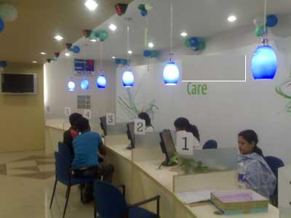

Branch profitability by serving the customer
To provide the best services is the biggest tool to promote the business profitability and efficiency in financial institutions. Now days competition in financial institutions is on the basis of good customer service.

Slide 27

Co-ordination and team work
Now a day’s trend of team work is at peak in all institutions. Every organization wants that its employees should have an ability to work in team atmosphere. Employee can learn easily more and more in team work. In financial institutions team work sprit enhance the efficiency of banks by offering financial services.

Slide 28


